Slide 1
CPU and Memory
Last Time
Major Ideas and Concepts
Components of the CPU
Concept of Registers
More About Registers
The Memory Unit
The Memory Capacity
The Fetch-Execute Instruction Cycle
Buses

Slide 2
Last Time
Stored computer concept
Equivalence and interchangeability of program code and data
Basic instruction set
Way instructions are formatted
Basic concept of addressing of data
Fetch-execute cycle

Slide 3
Major Ideas and Concepts
The concept, operation and interactions of CPU registers
The operation of memory, roles of the memory address register and memory data register
The fetch-execute cycle - the simple movement and addition of data between registers that implements the computer's instruction set
The relationship between the Little Man in the Little Man Computer and the steps in a fetch-execute cycle

Slide 4
Major Ideas and Concepts
The bus concept, the various types of buses and the signals that make up buses
The purposes for which buses are used within a computer system
The concept of a bus protocol
The characteristics of instruction sets: instruction formats and instruction classifications

Slide 5
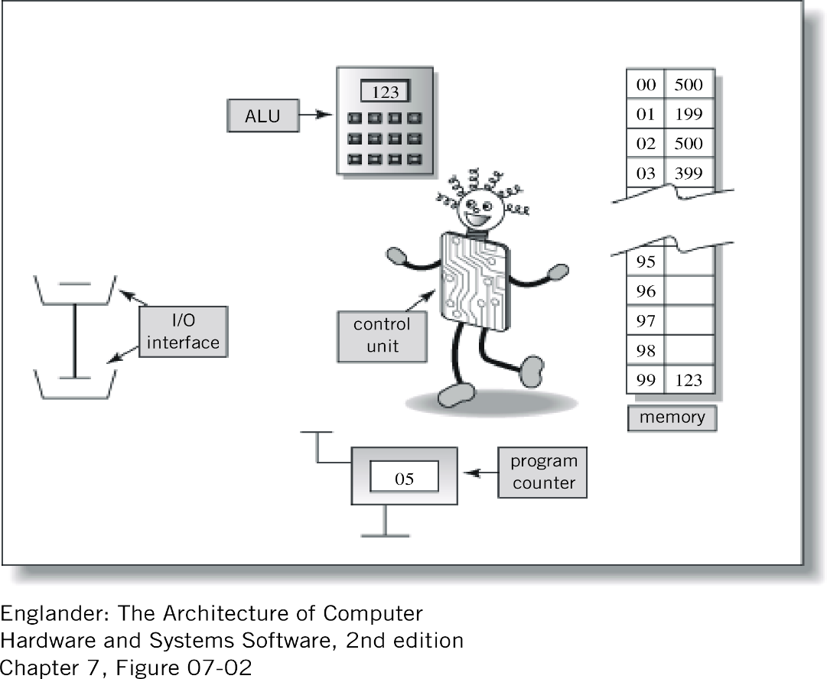
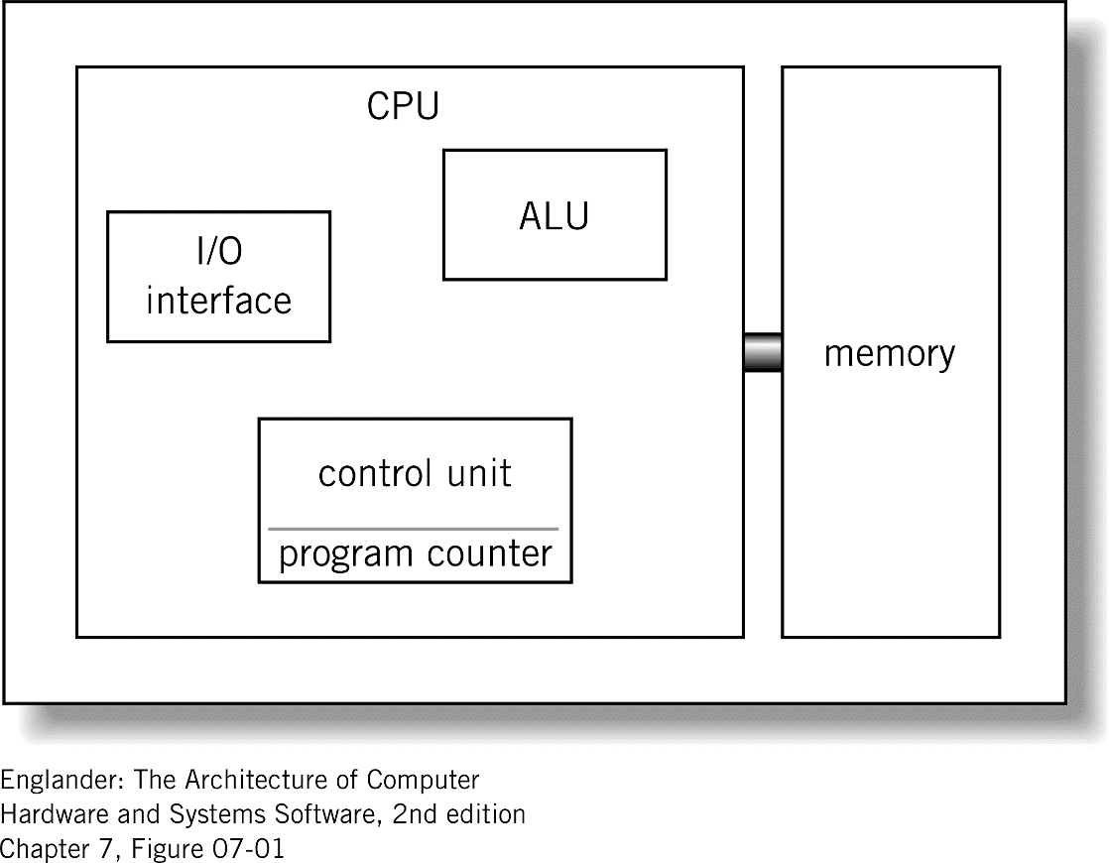
Components of the CPU

Slide 6
Concept of Registers
Unlike memory – where every address is just like every other address
Each register serves a particular purpose
Register is a single, permanent storage location
Hard-wired within the CPU, performs specific role.
Particular, pre-defined roles
Temporarily holds binary value for
  storage
  manipulation
  simple calculations

Slide 7
More About Registers
Program Counter Register (PCR) – holds the address of the current instruction being executed
Instruction Register (IR) – holds the actual instruction being executed.
Memory Address Register (MAR) – holds the address of the memory location.
Memory Data Register (MDR) – holds the data value that is being stored to or retrieved from the memory location currently addressed by the memory address register. Some times known as the memory buffer register.

Slide 8
More About Registers
General Purpose Registers – normally part of the arithmetic/logic unit, used by program instructions to temporarily store, manipulate or accumulate data or instructions
Status Registers – used for keeping track of unusual conditions, arithmetic carry, overflow, power failure and internal errors

Slide 9
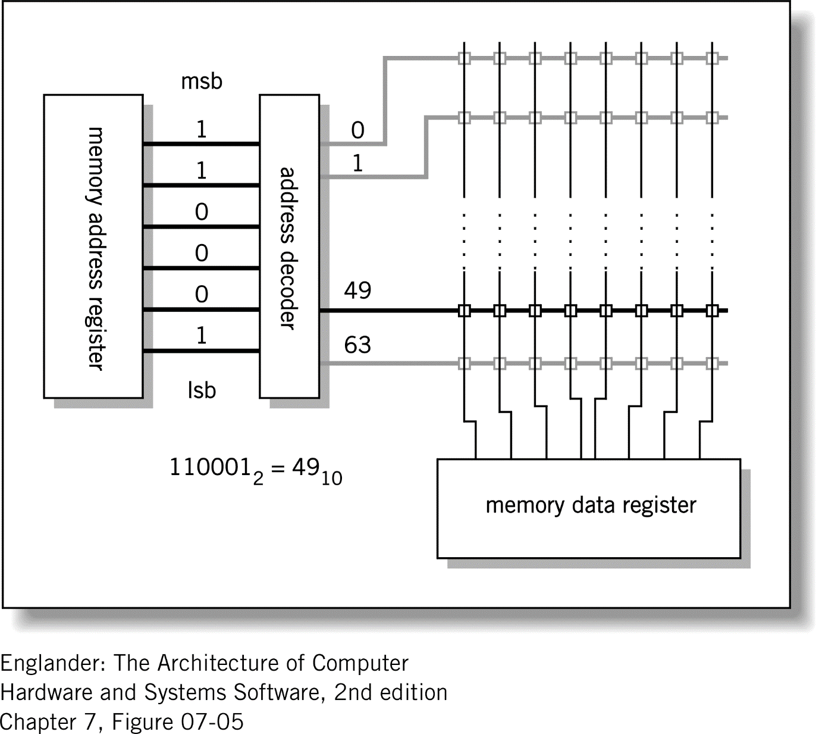

Slide 10
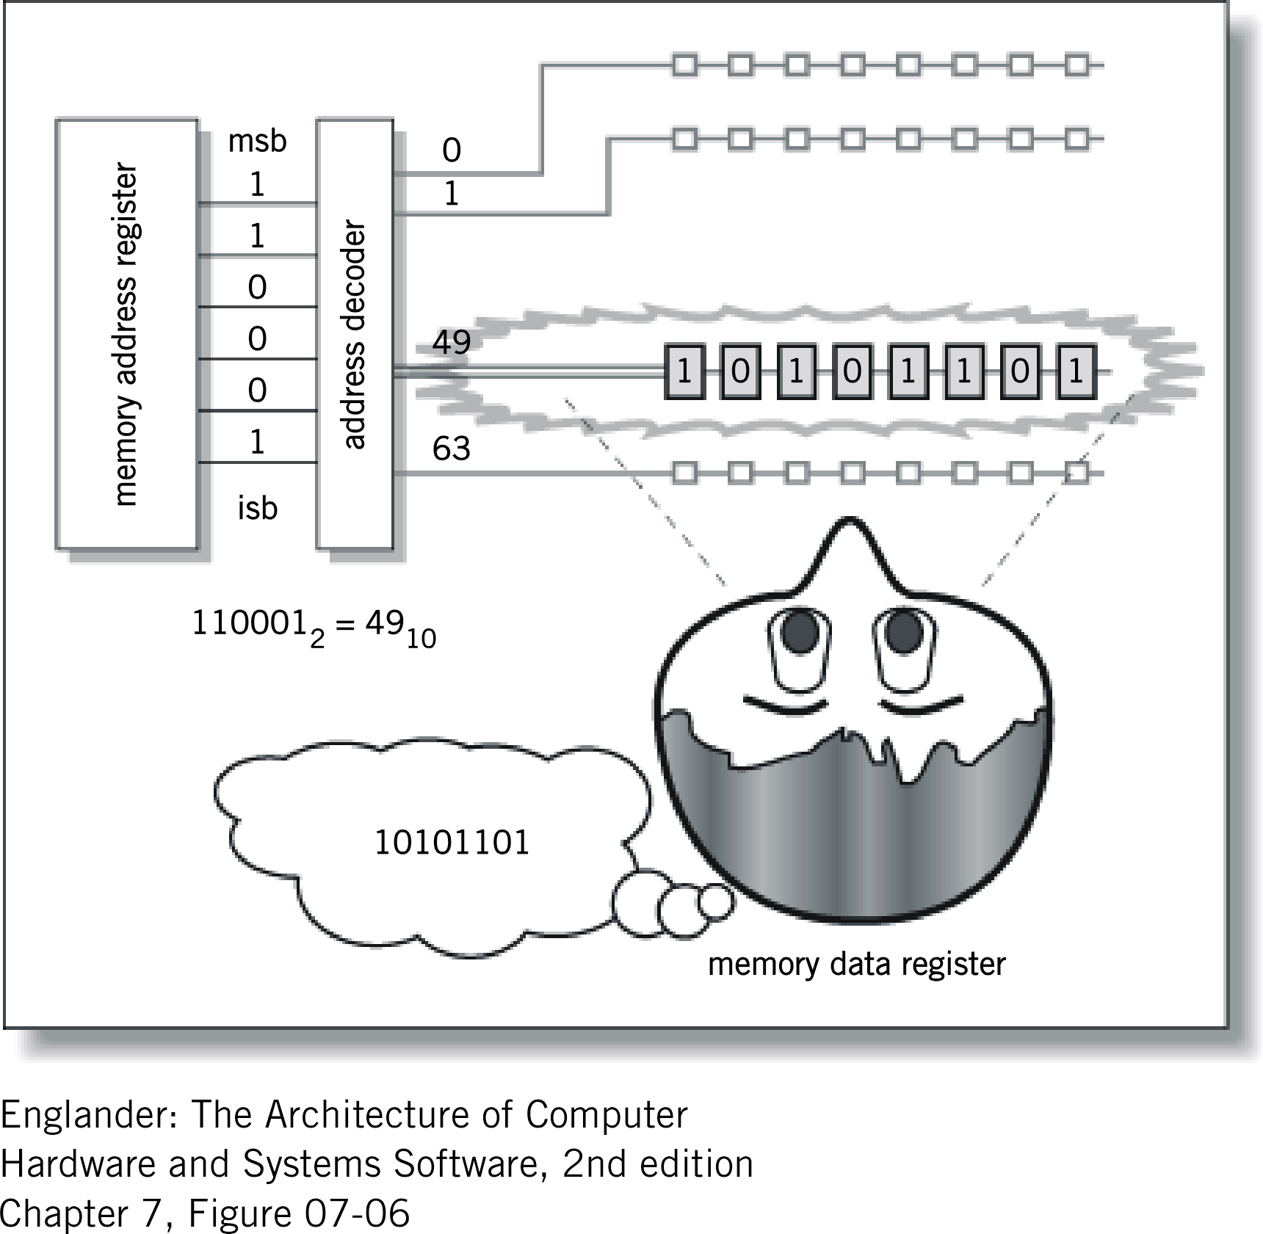

Slide 11
The Memory Unit
Core – expensive, slow, older technology, rarely used – only for special purpose applications. nonvolatile - retains its polarity even when power was no longer supplied
Static RAM – Random Access Memory, volatile, more expensive, faster, no refresh cycle
Dynamic RAM – Random Access Memory, volatile, less expensive, less energy, requires a refresh cycle
ROM – Read Only Memory used where software is built permanently into the computer nonvolatile, can’t be overwritten

Slide 12
The Memory Capacity
The number of bits in the Memory Address Register determines number of different address locations can be decoded
The number of bits in the address field of the instruction set, which establishes the number of memory locations can be directly addressed by an instruction.

Slide 13
The Instruction Cycle
Cycle comes in two parts:
Fetch portion – finds and retrieve instruction to execute
Execute portion – actually performs the work of the specified instruction

Slide 14
Fetch-Execute Instruction Cycle
Fetch Portion
Assume that the address of the current instruction is contained in the Program Counter Register (PCR) and it is a Load instruction
1. PCR to MAR - move the instruction from a specific memory location to Memory Address Register
2. MDR to IR - transfer the instruction to the Instruction Register, which will hold the instruction for the rest of the instruction cycle.
This completes the fetch portion of the cycle

Slide 15
Fetch-Execute Instruction Cycle
Execute Portion
3. IR [address] to MAR – preparation for step 4, transfer the address part of the instruction to the Memory Data Register
4. MDR to Accumulator (one of the general purpose registers) which prepares the memory module to read the actual data that will be copied into the calculator
5. PCR + 1 to PCR - increments the Program Counter Register to the next instruction address to be executed
The cycle repeats itself until … ?

Slide 16
Buses
Definition
A bus is defined as a group of electrical conductors suitable for carrying computer signals from one location to another
Each conductor in the bus is called a line
Buses are used for transferring data:
  between peripherals and the CPU
  between CPU and memory
  between different points with in the CPU (i.e. between registers.)

Slide 17
Bus Protocol
A specification that spells out the meaning of each line and each signal on that line
What result can you get by doing this?

Slide 18
Bus Types
Point-to-point – used to carry signals from a specific point to a specific point. Buses for serial and parallel ports are good examples.
Multipoint – signals are broadcast to every other point on the bus. Ethernet is a good example of a multipoint bus since the signal being sent by a particular computer is heard by every other computer on the network

Slide 19
Bus Uses
Backplane – broadcast bus used to connect the CPU with memory, and/or with a set of I/O cards. Sometimes known as a system bus.
Peripheral Control Interface – or PCI used for connecting external I/O devices to the CPU.
Accelerated Graphics Processor – a bus normally used to connect to a video card.

Slide 20
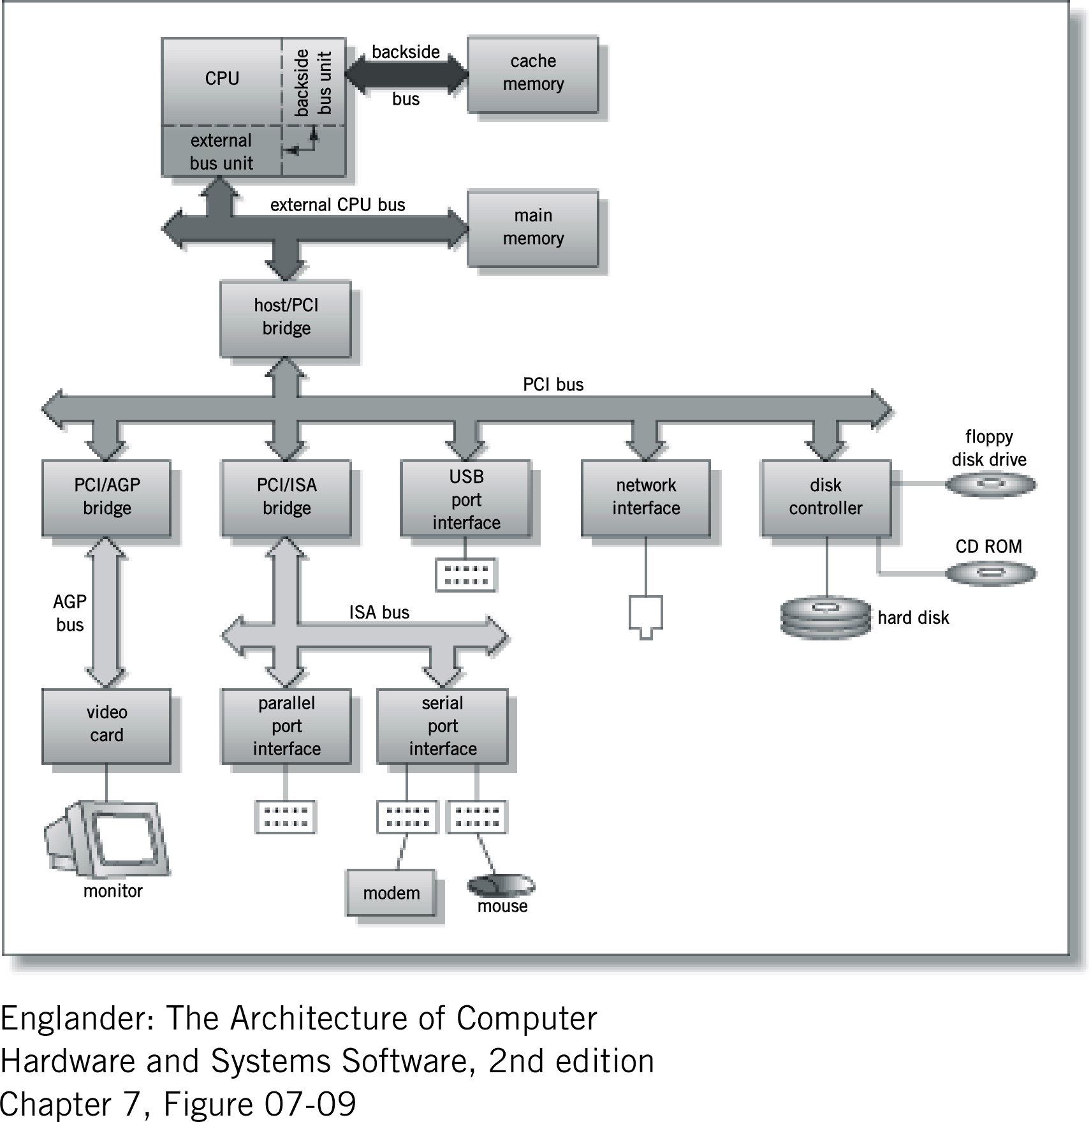
Typical Buses

Slide 21
Next Time
CPU Design

